Slide 1
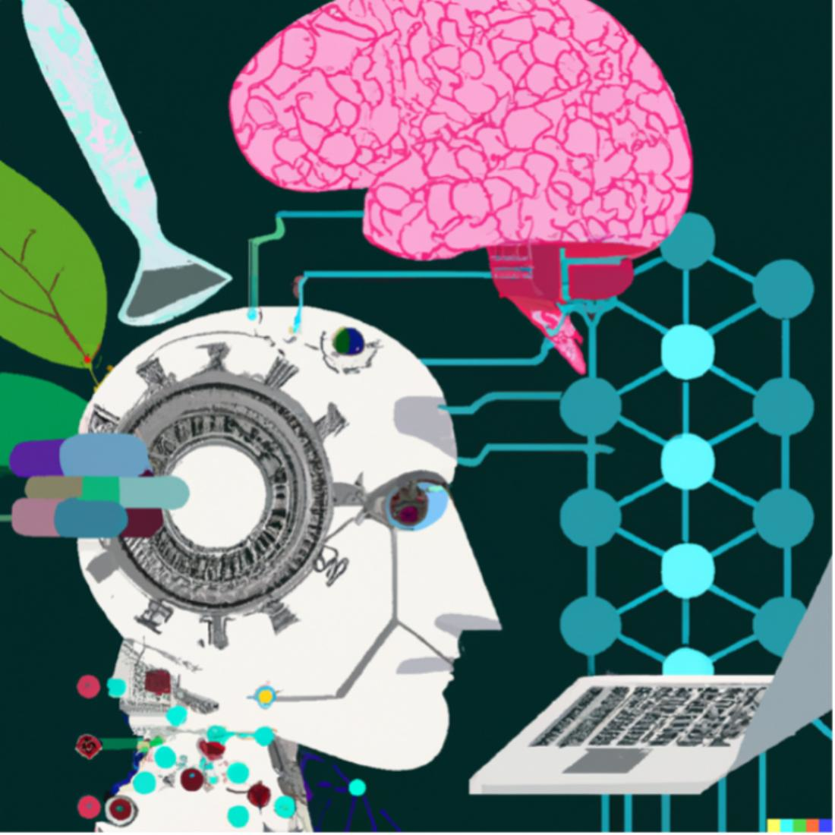
MODULE - 5
ARTIFICIAL INTELLIGENCE FOR MEDICAL APPLICATIONS

Slide 2
ARTIFICIAL INTELLIGENCE FOR MEDICAL APPLICATIONS Introduction to Artificial intelligence and machine learning in medical Science. Application of AI in Imaging and Computer-aided Diagnosis, Neuroscience and drug discovery, Genetic algorithms.

Slide 3
What is Artificial Intelligence?
Artificial Intelligence is the intelligence shown by machines that can be helpful to perform several tasks using sentiment analysis and Natural Language Processing (NLP).
Artificial intelligence (AI) is the term used to describe the use of computers and technology to simulate intelligent behaviour and critical thinking comparable to a human being.
Alan Turing (1950) was one of the founders of modern computers and AI. The “Turing test” was based on the fact that the intelligent behavior of a computer is the ability to achieve human level performance in cognition related tasks.

Slide 4
John McCarthy first described the term AI in 1956 as the science and engineering of making intelligent machines.
This technology allows machines to learn on their own from past data and the given information, make sense of it, and use this information to do various business tasks.
AI is a superset of Machine Learning and Deep Learning, and these technologies have their own sets of responsibilities while equipping machines.

Slide 5
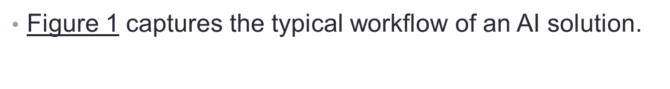
Artificial Intelligence and Machine learning in Medical Field
Artificially intelligent systems in healthcare have the following typical pattern. Such a system starts with a large amount of data, on these data machine-learning algorithms are employed to gain information, this information is then used to generate a useful output to solve a well-defined problem in the medical system.

Slide 6
Applications of AI in the field of medical sciences include matching patient symptoms to appropriate physician, patient diagnosis, patient prognosis, drug discovery, bot assistant that can translate languages, transcribe notes, and organize images and files.
AI in medicine can be classified into two subtypes:
Virtual and Physical.
The virtual part ranges from applications such as electronic health record systems to neural network-based guidance in treatment decisions.
The physical part deals with robots assisting in performing surgeries, intelligent prostheses for handicapped people, and elderly care.

Slide 7
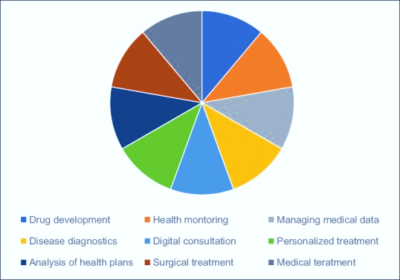
A lot of AI is already being utilized in the medical field, ranging from online scheduling of appointments, online check-ins in medical centers, digitization of medical records, reminder calls for follow-up appointments and immunization dates for children and pregnant females to drug dosage algorithms and adverse effect warnings while prescribing multidrug combinations.
Figure 2
Applications of artificial intelligence in health care

Slide 8
Great advances have been made in using artificially intelligent systems in case of patient diagnosis.
In the field of dermatology, clinical imaging data has been used to develop classification models to aid physicians in the diagnosis of skin cancer, skin lesions, and psoriasis.
Researchers at Google developed and trained a DCNN using 1,28,175 retinal fundus images to classify images as diabetic retinopathy and macular edema for adults with diabetes. There are several advantages of the existence of such an artificially intelligent model, such as:
Automated grading of diabetic retinopathy leading to increased
efficiency in diagnosing many patients in shorter time;
Serving as a second opinion opthalmologists;
Detection of diabetic retinopathy in early stages due to capability
of the model to study images at the granular level-something
impossible for a human opthalmologist to do;
Vast coverage of screening programs reducing barriers to access.

Slide 9
Role of AI in Healthcare
Accurate Cancer Diagnosis
Early Diagnosis of Fatal Blood Diseases
Customer Service Chatbots
Virtual Health Assistants
Treatment of Rare Diseases
Targeted Treatment
Automation of Redundant Healthcare Tasks
Management of Medical Records
Reduction of the Dosage Error
Robot-assisted Surgery
Automated Image Diagnosis
Fraud Detection
Clinical Trial Participation
Development of New Medicines
Improved Healthcare Access

Slide 10
Artificially intelligent systems are also being applied to enhance patient care, and provide support to physicians through the use of AI assistants.
Instantly finding which physicians are on call and scheduling the next available appointment; the AI system can also search multiple scheduling systems across different hospitals.
Answering prescription related questions, like drug availability and cost-effective alternative drugs.
Assisting doctors search hospital protocol, list of available clinical tools, and available drugs all through the use of a mobile application, thus improving workflow in the hospital.
The most recent application of AI in global healthcare is the prediction of emerging hotspots using contact tracing (Contact tracing is a disease control measure used by government authorities to limit spread of a disease), and flight traveler data to fight off the novel coronavirus (COVID-19) pandemic.

Slide 11
Applications of artificially intelligent systems in healthcare can be broadly classified into three categories :
Patient-oriented AI
Clinician-oriented AI and
Administrative and Operational-oriented AI.

Slide 12
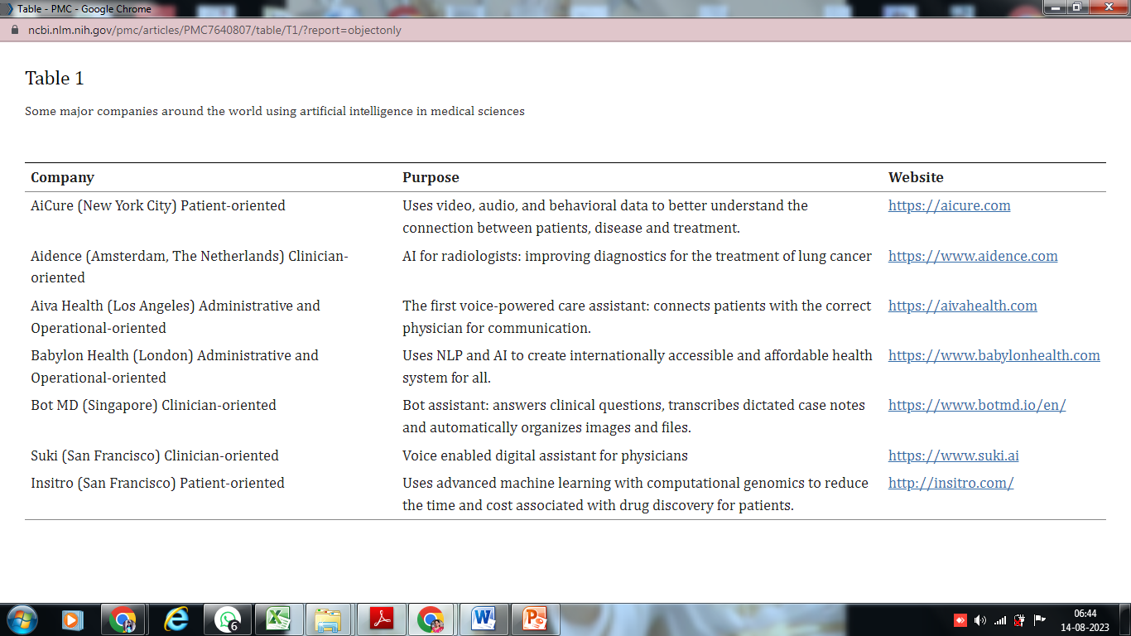

Slide 13
Application of AI in Imaging and Computer-aided Diagnosis
In the feld of computer aided detection/diagnosis (CAD) for medical images is starting to experience changes with the advent of an advanced artificial neural network called deep learning, which is a part of machine learning technology.
While the need for CAD in the clinical setting has been sufciently recognized, the limitations found in such conventional or traditional CADs are mainly owing to the following reasons:
– High development cost.
– high rate of false-positive marks, possibly leading to an
increased recall rate and unnecessary biopsies
–Not always efective in a clinical evaluation.
–Workfow and cost-efectiveness issues.
–Limited to specifc lesions.

Slide 14
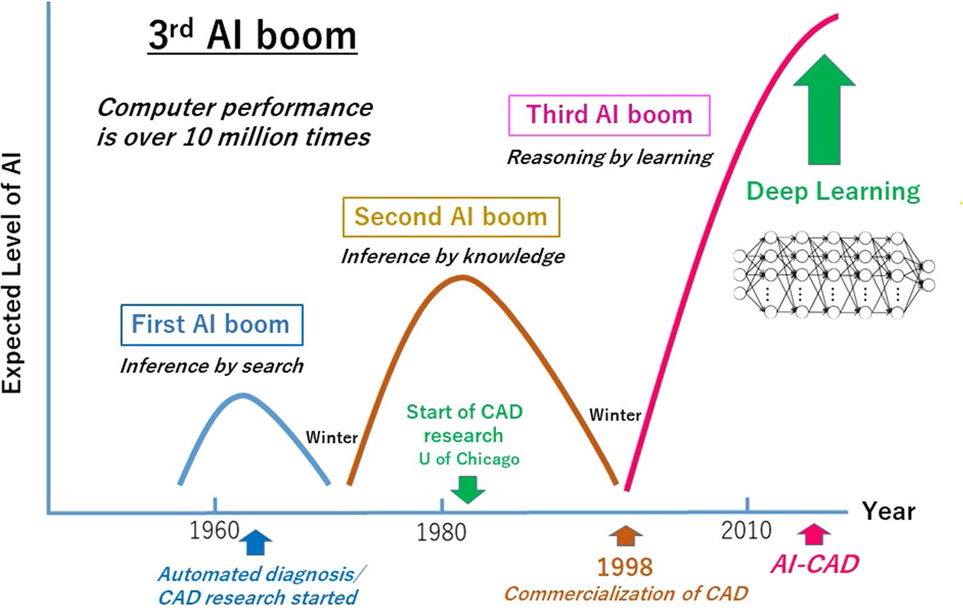

Slide 15
Three types of CAD
There are three types of CAD classified based on their
purposes.
– CADe (detection).
– CADx (diagnosis).
– CADt (triage).
CADe and CADx are used for the detection of diseases
on the image and classification of lesions into benign and
Malignant
CADx for breast MRIs was developed by Quantitative
Insights, CADx for breast MRIs presents an index indicating
the grade of QI score for the candidate lesion site and has a
similar image presentation function.
Triage refers to selection based on the severity of a
patient’s illness or trauma.

Slide 16
Traditional CAD
Basic research on CAD, including research and development aimed at automatic diagnosis, began in the 1960s. The first device to be approved by the U.S. Food and Drug Administration (FDA) in 1998 was a mammography CAD device made by R2 Technology, Inc. (now Hologic). Therefore,1998 is sometimes called “CAD first year.”
After that, commercialization has continued in the diagnostic imaging area to include chest radiographs, chest CT images, and CT colonoscopies.
While the need for CAD in the clinical setting has been sufficiently recognized, the limitations found in such conventional or traditional CADs are mainly owing to the following reasons:
–High development cost.
–A high rate of false-positive marks, possibly leading to an increased recall rate and unnecessary biopsies.
–Not always effective in a clinical evaluation.
–Workflow and cost-effectiveness issues.
–Limited to specific lesions.

Slide 17
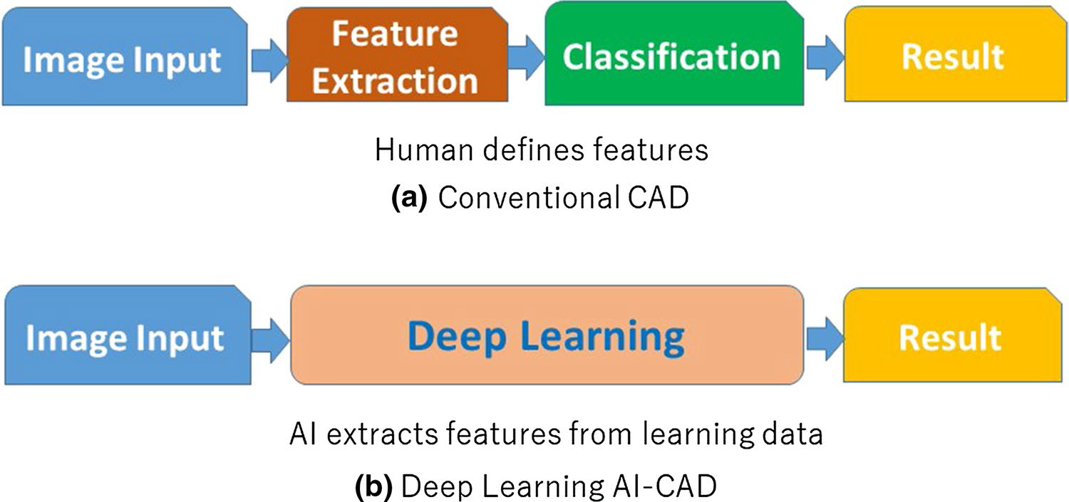

Slide 18
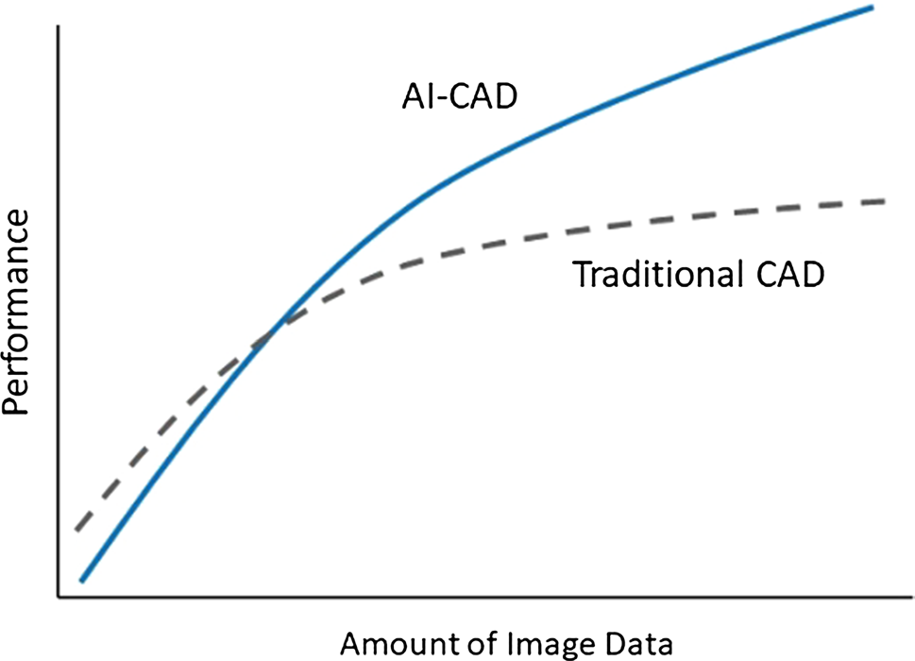

Slide 19
Remarkable AI‑CAD Applications
Fundus photographs :
The mass screening of fundus photographs can be used to diagnose not only eye diseases such as glaucoma but also diabetic retinopathy and hypertensive retinopathy, both for hypertension and arteriosclerosis degree determination.
Google collected about 130,000 fundus images and analyzed them using deep learning [50]. As a result, Google published an interesting paper in 2016 that had a detection sensitivity of about 98%, which is comparable to that of an ophthalmologist.

Slide 20
Following this, in March 2018, Google collected fundus photographs together with other medical care data from about 3,00,000 patients and predicted heart disease from the fundus photographs using deep learning processing. The factors considered in this study were age, gender, smoking habits, blood pressure levels, the likelihood of diabetes, and body mass index (BMI) indicating obesity. It can be said that this has already exceeded human work.
Dermatology images :
In January 2017, a research group at Stanford University used AI to diagnose skin cancer .In their study, images of approximately 130,000 skin lesions were collected from the internet, and “skin cancer (melanoma),” “benign tumor,” etc. were learned by deep learning, and as a result, AI was able to diagnose skin cancer with accuracy equivalent to a dermatologist.

Slide 21
3.Pathological images :
(Pathology is study of what causes disease and disease's specific effects on biological tissues and fluids.)
Tremendous advancements in deep learning have enabled a synergy with artificial intelligence (AI), allowing for image-based diagnosis on the background of digital pathology.
AI-based tools save pathologists time and eliminate errors in a study of pathological images
On detection of lymph node metastasis of breast cancer, the authors made a comparison of judgment results concerning the presence or absence of lymph node metastasis for deep learning AI versus 11 pathologists with an average experience of 16 years. As a result, the average value of the AUC (the area under the ROC curve) of AI was 0.994, and the average value of 11 doctors was 0.810, with a reading time limit.

Slide 22
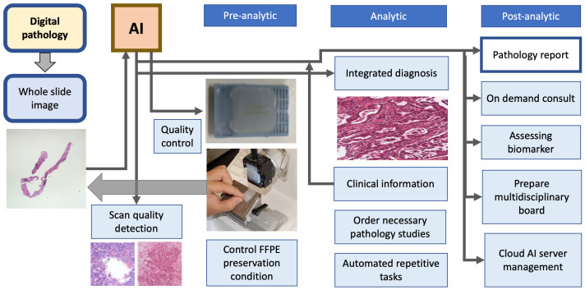
The digital pathology supplies whole-slide images to artificial intelligence, which performs quality control of pre-analytic phase, analytic phase and post-analytic phase of pathology laboratory process.

Slide 23
4.Breast imaging :
AI has been used to analyze mammography images in most studies mainly for the detection and classification of breast mass and microcalcifications, breast mass segmentation, breast density assessment, breast cancer risk assessment and image quality improvement.
The identification and segmentation of lesions in breast ultrasound images saves a considerable amount of time for ultrasound physicians to quickly identify and diagnose diseases and provide a foundation and guarantee for the development of AI for automatic diagnosis of breast diseases.
The study of DL in breast MRI mainly focuses on the detection, segmentation, characterization and classification of breast lesions. Ignacio Alvarez Illan et al. detected and segmented non-mass-enhanced lesions on dynamic contrast-enhanced magnetic resonance imaging (DCE-MRI) of the breast with a CAD system, and the optimized CAD system reduced and controlled the false positive rate and finally achieved satisfactory results.

Slide 24
The CAD system can improve the sensitivity of examination, decrease the false positive rate, and reduce unnecessary biopsy and psychological burden of patients .
5.Chest Imaging :
AI was used in the Identification of COVID-19 Pneumonia at Chest X-ray.
CXR can help in identify signs of pneumonia, also in case of negative RT-PCR test: sensitivity of CXR greatly depends on the stage of the lung infection and on the extent of the disease, as well as on the technical quality of the exam (usually performed bedside in critically ill patients), ranging from 50% to 84%.
As diagnostic images in COVID-19 correlate with disease severity, AI can be used as a prognostic tool, helping monitoring disease evolution and course, and identifying patients at risk of ICU admission.
AI model using deep three dimensional learning could assess cancer risk on low-dose CT lung cancer screening studies as well as, or even better than, experienced radiologists.

Slide 25
AI in drug discovery
The vast chemical space, comprising >10⁶⁰ molecules, fosters the development of a large number of drug molecules
AI can recognize hit and lead compounds, and provide a quicker validation of the drug target and optimization of the drug structure design

Slide 26
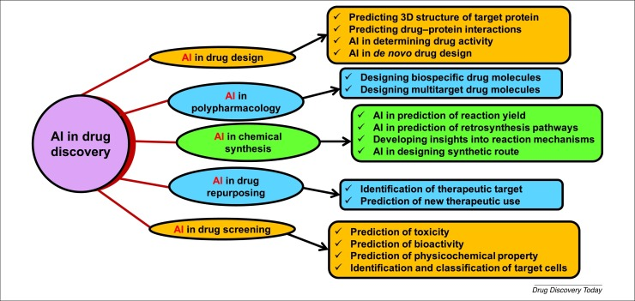

Slide 27
AI in drug discovery is the design of novel compounds with specific properties and activities. AI-based approaches, on the other hand, can enable the rapid and efficient design of novel compounds with desirable properties and activities.
For example, a deep learning (DL) algorithm has recently been trained on a dataset of known drug compounds and their corresponding properties, to propose new therapeutic molecules with desirable characteristics such as solubility and activity, demonstrating the potential of these methods for the rapid and efficient design of new drug candidates.
Recently, DeepMind has made a significant contribution to the field of AI research with the development of AlphaFold, a revolutionary software platform for advancing our understanding of biology . It is a powerful algorithm that uses protein sequence data and AI to predict the proteins’ corresponding three-dimensional structures.

Slide 28
ML techniques and molecular dynamics (MD) simulations are currently being used in the field of de novo drug design to improve efficiency and accuracy. The technique of combining these methodologies is being explored to take advantage of the synergies between them .
The use of interpretable machine learning (IML) and DL methods is also contributing to this effort. By leveraging the power of AI and MD, researchers are able to design drugs more effectively and efficiently than ever before.

Slide 29
.Case Studies of Successful AI-Aided Drug Discovery Efforts
The potential of AI in the context of drug discovery has been demonstrated in several case studies. For example, the successful use of AI to identify novel compounds for the treatment of cancer has recently been reported by Gupta, R., et al
The use of ML to identify small-molecule inhibitors of the protein MEK has recently been described. MEK is also a possible target for the treatment of cancer, but the development of effective inhibitors has been challenging.
A pioneering ML approach has identified powerful types of antibiotic from a pool of more than 100 million molecules, including one that works against a wide range of bacteria, such as tuberculosis and untreatable bacterial strains.
AI-powered approaches have been able to identify promising drug candidates in a fraction of the time that it would take when using traditional methods.

Slide 30
Application of Artificial Intelligence in Genetic Algorithm(GA) :
A genetic algorithm (GA) is an artificial intelligence search metaheuristic that is derived from the process of biological organism evolution.
Genetic algorithms were described in University of Michigan 1960s and 1970s by John Holland.
Genetic algorithms are a subset of the evolutionary algorithm set. The design of evolutionary algorithms is based on processes which occur in living organisms in nature, for example, inheritance, mutation, selection and crossover.
GA’s are uniquely distinguished by having a parallel population based search with stochastic selection of many individual solutions, stochastic crossover and mutation. Many other search methods have some of these elements, but only GA’s have this particular combination.
Genetic algorithms are used various fields of biology, biotechnology, computer science, engineering, economics, chemistry, manufacturing, mathematics, medicine and pharmacology and other fields and have numerous advantages and disadvantages.

Slide 31
The GA requires a fitness statistics or function since it emulates the concept of solution evolution by stochastically developing generations of solution populations.
This algorithm is applicable to search for the solution of high degree of complexity that often involves attributes that are large, non-linear and discrete in nature.
However, GA does not guarantee that optimality can be found but the results are usually close to the global optimum.

Slide 32
Advantages of Genetic Algorithm
Genetic algorithm have quite a number of advantages which makes it as one of the most preferable and widespread search algorithms in Artificial Intelligence.
Capability of solving any optimization problem based on chromosome approach.
Capability to handle multiple solution search spaces .
Genetic algorithms are less complex and more straightforward compared to other algorithms.
Genetic algorithms are easier to be transferred and applied in different platforms, thereby increasing its flexibility.
Many algorithms in AI are complete and optimal in finding a solution; however, these algorithms are only efficient for single objective solutions which mean there is only a single criterion for the solution state.
Genetic algorithm has this capability to generate efficient solutions in such a complex and mathematically sophisticated environments. This process is performed by using the described implementation operators such as crossover and mutation where the new solutions will inherit from more than one previous chromosome.

Slide 33
Genetic algorithms are characterized by the following attributes :
Metaheuristics guide search process with defined strategies. Although randomized, metaheuristic algorithms such as GA are not random searches.
Their goal is to efficiently search the state space to find near-optimal solutions. Thus metaheuristic searches include simple local search algorithms and complex learning processes.
Metaheuristic algorithms are approximate and usually non-deterministic.
Metaheuristic algorithms are not problemspecific. They make few assumptions about the optimization or search problem being solved, and therefore they can be used for a variety of problems.

Slide 34
Genetic Algorithm Applications
Robotics:
Genetic algorithm will provide this capability to automatically generate a collection of optimal designs which can be used for specific tasks and activities. This approach result in the generation of robots which can perform several tasks and process more comprehensive applications.
Another aspect of using GA in robotics is in navigation process. GA provides optimized solutions for navigation process by which the robot can reach to its required destination without being lost or hitting other objects in the environment.
In navigation algorithm each chromosome represents a series of path nodes where each node is a gene. Each gene has an x and y value and a Boolean value which represents whether the next node reachable form the current node or no. By using this approach robot will not only be able to always find a way to the target without hitting the objects but also it will be able to find the most optimal path.

Slide 35
2 . Engineering design:
GA can be integrated into computer based engineering design applications. By following such a strategy the application will be able to analyze different aspect of engineering design principles when generating a new design for a given problem. This approach in addition to providing the required design will also assist the designers to identify the frailties and possible failure points of the design. Such an approach is currently being used in many engineering industries such as aerospace, civil, automotive, robotics, electronics, mechatronics etc.
Genetic algorithm is currently being used to improve the outcome to the fullest. There are many more fields such as telecommunication routing, trip and shipment routing, gaming, encryption and code breaking, chemical analysis, finance strategies, marketing strategies, which also uses the GA.

Slide 36
3. Data Encryption :
In the field of cryptology, Genetic Algorithm is being used to produce a new advance encryption by using the operations of Crossover and Mutation.
Cryptosystem is a group of algorithm that contains secret keys for the encoding of information or messages into cipher text and decodes them back into their original state.
A new symmetrical block ciphering system called ICIGA (Improved Cryptology Inspired by Genetic Algorithms) enables the generation of a unique session key in a random process.
In the ciphering process, the first part is split into block of equal size and being used for the generation of the secret key. The secret key being created will then be used for ciphering other parts of the message.
The ciphering process also involves the genetic operations of crossover and mutation

Slide 37
4. Computer Gaming :
In the field of gaming, the opponent of the human player is often a form of advance artificial intelligence (AI) that incorporates Genetic Algorithm. Strategies that are being used in the past are being programmed using GA to ensure that the AI is able to learn and improve from the past experience.
The learning technique allows the AI to avoid repeating past mistakes, which therefore increase the playability of the game. This enables a more realistic experience to the human player as they are required to change their strategies from time to time.
It also helps to avoid the scenario of a situation whereby the human player found a sequence of steps which ultimately leads to success, which means that the game does not pose any challenge anymore. For the GA to work, it requires a method to represent the challenge in terms of the solution and a fitness function for it to decide the quality of an instance.
The fitness function first receives a mutated instantiation of an entity and proceeds to determine its quality. Next, this particular function is customized to fit the problem domain As soon as a genetic representation and fitness function are defined, the GA will instantiate the initial candidates that will then apply the repetitive range of operators made up of selection, crossover and selection to improve the fitness value of the candidates

Slide 38
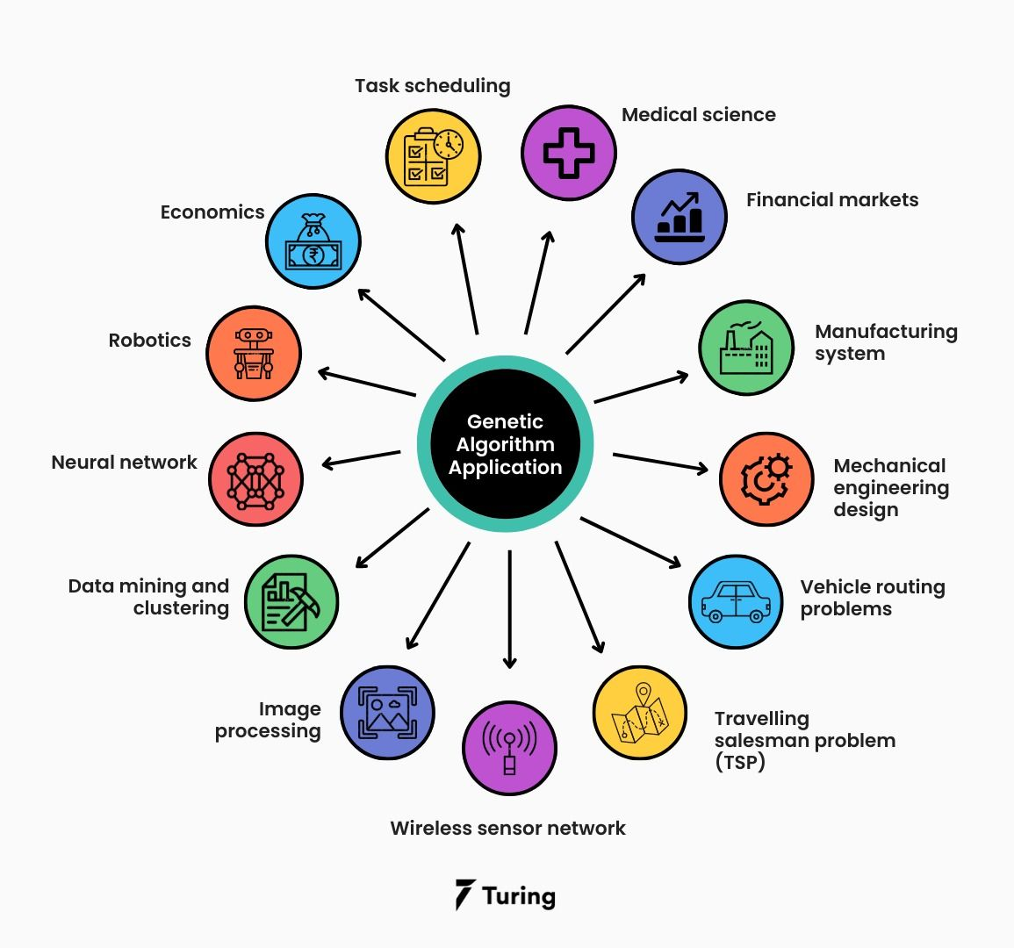

Slide 39
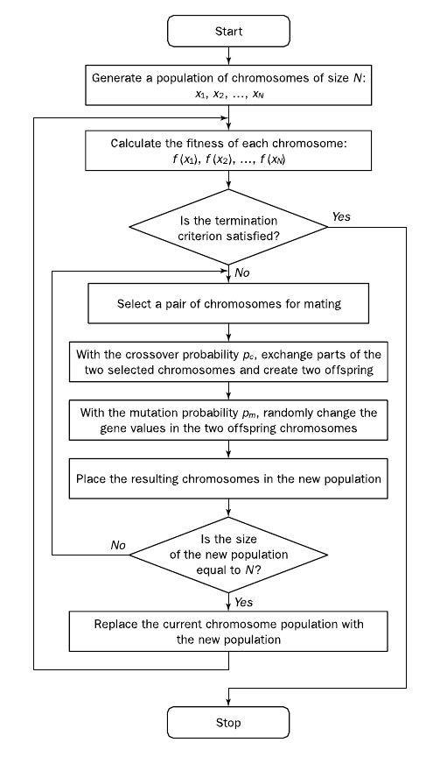
A basic Genetic Algorithm

Slide 40
Application of AI in Neuroscience
AI-based systems have helped neuroscientists test their hypotheses and analyze neuroimaging data, which, in turn, help with the early prediction and diagnosis of psychiatric disorders.
Furthermore, these AI systems set up an interface with the brain, extract neurological signals, and generate commands that help devices, such as robotic arms, to move paralyzed human parts.

Slide 41
Neuroscience inspired the design of AI systems.
Similar to neurons in the human brain, artificial neural networks (ANNs) have several interconnected units that work in parallel. Likewise, the concept of Hebbian learning and brain structure helped Frank Rosenblatt design a simple ANN called perceptron in the 1950s.
The human brain's working memory feature inspired scientists to design a recurrent neural network (RNN). The RNN architecture allowed the use of the past output as input to predict the subsequent output. Notably, one type of RNN known as the long short-term memory (LSTM) network can handle long-term dependencies, such as those that exist in text summarization.
Scientists found inspiration for convolutional neural networks (CNN) from the architecture of the brain's ventral visual stream. In RL, an intelligent agent like a computer understands the state of the environment to dictate the action. Moreover, the computer learns to repeat some tasks based on rewards and avoid others based on penalties.

Slide 42
In deep RL (reinforcement learning), a neural network provides a gradient-descent-based nonlinear mapping between the current states of the environment and all feasible actions. Although deep RL has enabled the machine recognition of sounds, text, and images, this technology consumes immense computing resources.
Spiking neural networks (SNNs) are being developed, as they work like biological neurons and are more energy efficient. SNNs transmit information in the form of an electric signal to another artificial neuron when its membrane potential hits a particular threshold.

Slide 43
How is AI used to study neuroscience?
Several AI-assisted brain computer/machine interface (BCI) applications have been developed to help people with neuromuscular disorders, such as cerebral palsy or spinal cord injuries.
AI has been widely used for controlling prostheses, as demonstrated by BrainGate, which is an implant that allows users to control limb movements.
Detecting neurological infections like meningitis is tedious due to their wide range of symptoms.
However, AI-based approaches using various predictor variables such as cerebrospinal fluid (CSF) neutrophils, lymphocytes, and neutrophil-to-lymphocyte ratio (NLR) could predict the type of meningitis with high precision.
AI is also associated with several benefits when applied to neuro-oncology, as it can potentially provide precise initial diagnoses and therapeutic options.

Slide 44
AI tools for modeling the brain
Application of AI involves using ANNs (artificial neural networks) as a model of neural computation. ANNs were originally developed as models of the brain.
The pioneering researchers, such as John von Neumann (who invented the modern ‘‘von Neumann’’ computer architecture) and Frank Rosenblatt (who invented the ‘‘perceptron,’’ the first neural network system to learn from examples), had as their goal not only to build machines that could mimic human thought and reasoning, but also to understand how the brain computes (Lindsay 2021).
Recent successes were facilitated by newly developed experimental techniques for monitoring the activity of large populations of neurons. This allowed researchers to compare ANNs and real brains more directly, leading to the discovery that the representations that emerge in ANNs trained on relevant tasks can bear striking resemblance to those seen in the real brain.
This correspondence has emerged in both feed forward and recurrent neural networks across many brain areas, including low- and high-level visual areas, language areas, motor areas, and prefrontal areas.

Slide 45
This use of ANNs as a model of real neural computation was further pursued in the 1980s by cognitive scientists whose explicit goal was to understand and model human cognition.
Similarly, the research in the 1980s that led to the development of reinforcement learning was also primarily concerned with modeling how animals learned from ‘‘trial-and-error’’ (Sutton and Barto 2018).
Indeed, at that time, a key driving premise of cognitive science was that we could study intelligence as a general phenomenon, using AI models to understand the mind and, in turn, using our understanding of the mind to build better AI systems. Researchers from various domains, including both those who used ANN or reinforcement learning models and those who used more traditional logic-based models (sometimes referred to as ‘‘Good Old-Fashioned AI,’’ or GOFAI), agreed that neuroscience/psychology and AI were concerned with many of the same problems and would benefit from interdisciplinary interactions.

Slide 46
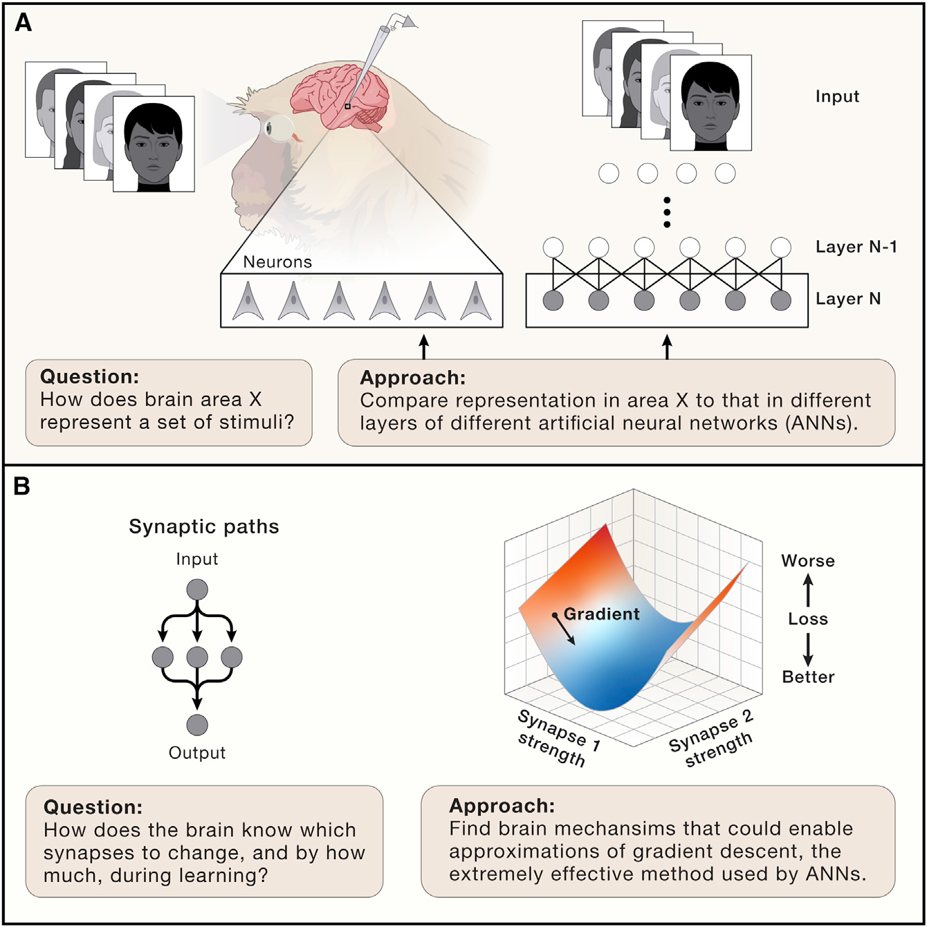
How ANNs are helping us to understand brain function and plasticity

Slide 47
In Fig (A) ANNs are providing neuroscientists with a rich set of models to explain neural activity in different brain areas, an important step toward understanding how complex functions such as face recognition are accomplished by the brain. Researchers can show a set of stimuli to an animal, record responses of neurons in that area, and then ask how well different ANNs capture the responses. One popular strategy is to model a neuron as a linear combination of ANN units and then ask how much variance in the neural response is explained by the linear model.
In Fig (B) In both brains and ANNs, there are many possible synaptic paths leading from input to output. For example, here there are three possible paths and six possible synapses. This makes it challenging to know which synapses should change during learning, an issue known as the ‘‘credit assignment problem.’’
ANNs solve this problem by using the gradient of a loss function to determine how to change synapses.
Recent work in computational neuroscience shows the brain has mechanisms that could enable approximations to gradient descent.

